Slide 1
Jermyn Borough Council Meeting
3/18/21

Slide 2

Meeting Agenda
Call to Order
Pledge of Allegiance
Roll Call
Previous Meeting Minutes
Ratification of Bills Paid
Treasurer’s Report/Bills Payable
Correspondence
Public Comment
Professional Reports
Committee Reports
Borough Manager Report
Bacon St. Sewer Project Bids
Climate Action Plan
Bonnie Dr.
Enerlogics MOU
Server
Executive Session
New Business
Adjournment

Slide 3

Treasurer’s report
3/18/21
ASSETS
    Capital Reserve - DPW 10,397.72
    Capital Reserve - Police 3,620.18
    Crime Watch Fund 755.44
    General Fund - Community 153,732.27
    General Fund - FNB 1,906.66
    Holiday Lights Fund 543.90

Slide 4
Treasurer’s report
3/18/21
ASSETS
      Investment - General Fund 1,001.42
      Investment - Liquid Fuels 33,812.22
      Investment - Paving Fund 1,011.91
      Investment - Recycling 5,003.16
      Investment - Refuse 2,604.77
      Liquid Fuels - FNB 72,767.57
      Petty Cash 151.42
      Recreations Fund 13,093.22
      Recycling - Community 7,773.52
      Refuse Checking - FNB 29,418.20
Total Checking/Savings 337,593.58

Slide 5
Treasurer’s report
Accounts Payable 27,625.13

Slide 6


Slide 7
Jermyn Borough General Employee Pension Plan Valuation
Date | Value | Change
2/28/2019 | $25,939.21 | $2,523.77
3/31/2019 | $26,609.33 | $670.12
4/30/2019 | $27,792.58 | $1,183.25
5/31/2019 | $27,762.08 | -$30.50
6/30/2019 | $30,163.00 | $2,400.92
7/31/2019 | $31,307.99 | $1,144.99
8/31/2019 | $32,491.86 | $1,183.87
9/30/2019 | $33,813.53 | $1,321.67
10/31/2019 | $35,460.80 | $1,647.27
11/30/2019 | $36,983.55 | $1,522.75
12/31/2019 | $38,645.55 | $1,662.00
1/31/2020 | $40,327.05 | $1,681.50
2/29/2020 | $39,759.82 | -$567.23
3/31/2020 | $37,349.22 | -$2,410.60
4/30/2020 | $40,874.93 | $3,525.71
5/31/2020 | $43,293.88 | $2,418.95
6/30/2020 | $45,559.06 | $2,265.18
7/31/2020 | $48,053.80 | $2,494.74
8/31/2020 | $51,401.24 | $3,347.44
9/30/2020 | $51,473.47 | $72.23
10/31/2020 | $51,737.09 | $263.62
11/30/2020 | $56,900.12 | $5,163.03
12/31/2020 | $59,697.92 | $2,797.80
1/31/2021 | $60,434.30 | $736.38
2/28/2021 | $63,540.03 | $3,105.73

Slide 8
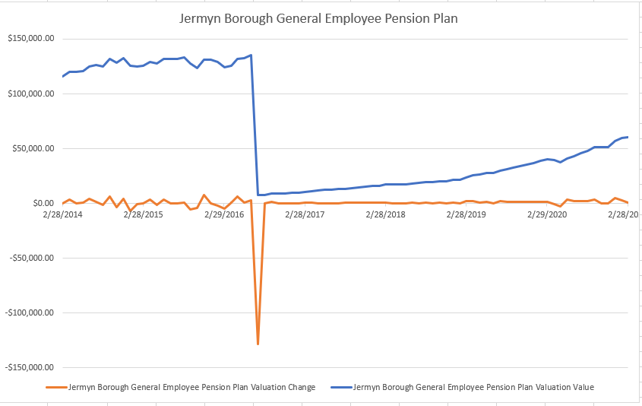

Slide 9
Jermyn Borough Police Officer Pension Plan Valuation
Date | Value | Change
2/28/2019 | 440,609.00 | $42,951.10
3/31/2019 | 443,655.49 | $3,046.49
4/30/2019 | 452,233.69 | $8,578.20
5/31/2019 | 435,544.34 | -$16,689.35
6/30/2019 | 450,800.80 | $15,256.46
7/31/2019 | 451,062.71 | $261.91
8/31/2019 | 446,203.33 | -$4,859.38
9/30/2019 | 446,043.85 | -$159.48
10/31/2019 | 467,082.31 | $21,038.46
11/30/2019 | 473,175.35 | $6,093.04
12/31/2019 | 480,217.58 | $7,042.23
1/31/2020 | 477,122.56 | -$3,095.02
2/29/2020 | 453,423.83 | -$23,698.73
3/31/2020 | 412,072.61 | -$41,351.22
4/30/2020 | 437,229.25 | $25,156.64
5/31/2020 | 450,055.98 | $12,826.73
6/30/2020 | 455,640.58 | $5,584.60
7/31/2020 | 468,358.69 | $12,718.11
8/31/2020 | 483,401.64 | $15,042.95
9/30/2020 | 472,550.34 | -$10,851.30
10/31/2020 | 461,969.26 | -$10,581.08
11/30/2020 | 497,033.61 | $35,064.35
12/31/2020 | 509,995.50 | $12,961.89
1/31/2021 | 505,410.61 | -$4,584.89
2/28/2021 | 514,685.82 | $9,275.21

Slide 10
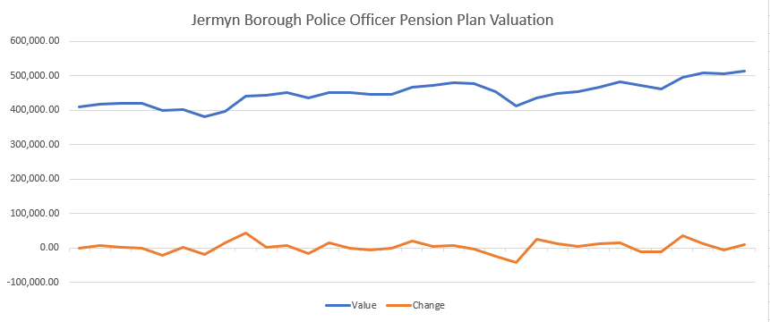

Slide 11


